Slide 1


Systems & MicroController Division
Overview of Systems Engineering Fundamentals
- Model-based Systems Engineering -
Minneapolis 11-08-01
Hans-Peter Hoffmann, Ph.D.
Director and Chief Methodologist for Systems Design
I-Logix Inc.
3 Riverside Drive
Andover MA 01810
USA
tel: 978-645-3022 . fax: 978-682-5995
e-mail:
peterh@ilogix.com
http://www.ilogix.com
Page <number>
H-P Hoffmann, Ph.D. Model-based Systems Engineering

Slide 2
Model-based Systems Engineering
    1. Process Overview:
    Model-based System Development
        The “V” Development Process
        Requirements Capture (“Use Cases”)
        Systems Analysis and Architectural Design
        Transition to SW Design
    2. Modeling Languages
    3. Model-based Verification/Validation
    4. Documentation in a Model-based Development
Page <number>
H-P Hoffmann, Ph.D. Model-based Systems Engineering

Slide 3
Shortcomings in System Developments
The “Throw-it-over-the-Fence” Process
Software Engineers
System Engineers
Electrical Engineers
Test Engineers
Copyright I-Logix
Mechanical Engineers
Requirements-
Analysis
Systems
Analysis &
Design
HW/SW
Design
HW/SW
Implementation
Module
Integration &
Test
System
Integration &
Test
System
Acceptance
Costs of
Design
Changes
Time
Page <number>
H-P Hoffmann, Ph.D. Model-based Systems Engineering

Slide 4
Improving the Development Process:
“Concurrent Engineering”
Software Engineers
System Engineers
Electrical Engineers
Test Engineers
Copyright I-Logix
Mechanical Engineers
Requirements-
Analysis
Systems
Analysis &
Design
HW/SW
Design
HW/SW
Implementation
Module
Integration &
Test
System
Integration &
Test
System
Acceptance
System Engineers
Software Engineers
Electrical Engineers
Mechanical Engineers
Test Engineers
Page <number>
H-P Hoffmann, Ph.D. Model-based Systems Engineering

Slide 5

Model/Scenario-based System Development
The iterative Process (“Micro-Cycles”)
System Modification
Use Case Models
Requirements
Analysis
Test Scenarios
Test Scenarios
System
Acceptance
V&V
Analysis
Copyright I-Logix
System- /
Performance- Model
Design
Implementation
System
Integration & Test
Systems
Analysis & Design
Knowledge Base *
Iterative Prototype
Implementation Model
HW / SW
Design
Module
Integration & Test
* Configuration controlled Knowledge
that is increasing in Understanding
until Completion of the System:
Requirements Documentation
Requirements Traceability
Model Data/Parameters
Test Definition/Vectors
HW / SW
Implementation
& Unit Test
Page <number>
H-P Hoffmann, Ph.D. Model-based Systems Engineering

Slide 6
Requirements
Analysis
T
    Requirements Capture
E
S
System
T
Acceptance
/
P
A
R
A
M
Systems
E
System
Analysis &
T
Integration & Test
Design
E
R
-
D
A
T
HW / SW
A
Design
B
Module
A
Integration & Test
S
E
HW / SW
Implementation
& Unit Test
Basic tools for requirements capture are Use Cases and Scenarios
A Use Case describes a specific usage (“operational thread”)
of a system.
  It specifies the behavior as perceived by
  the user(s) and the message flow between
  the user(s) and the use case.
  It does not reveal the system’s internal
  structure (“black-box view”)
A Scenario is a specific path through a Use Case .
Copyright I-Logix
Page <number>
H-P Hoffmann, Ph.D. Model-based Systems Engineering

Slide 7
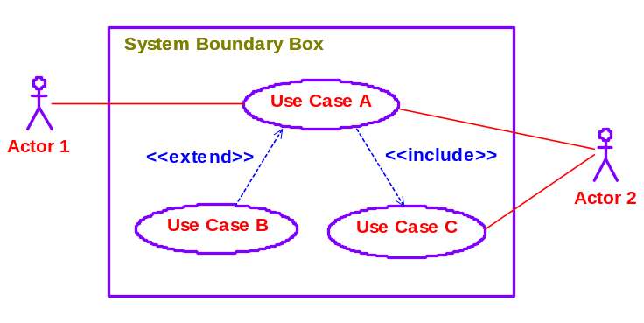
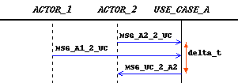
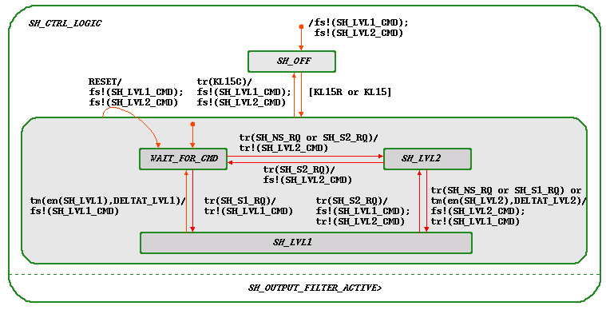
Requirements
Analysis
T
E
Languages for Requirements Capture
S
System
T
Acceptance
/
P
A
R
A
M
Systems
E
System
Analysis &
T
Integration & Test
Design
E
R
-
D
A
T
HW / SW
A
Design
B
Module
A
Integration & Test
S
Functional /
Non-functional
Requirements
E
HW / SW
Implementation
& Unit Test
Copyright I-Logix
Use Case Diagrams
Sequence Diagrams
capturing a specific use case scenario
Statecharts
capturing all possible use case scenarios
Page <number>
H-P Hoffmann, Ph.D. Model-based Systems Engineering

Slide 8
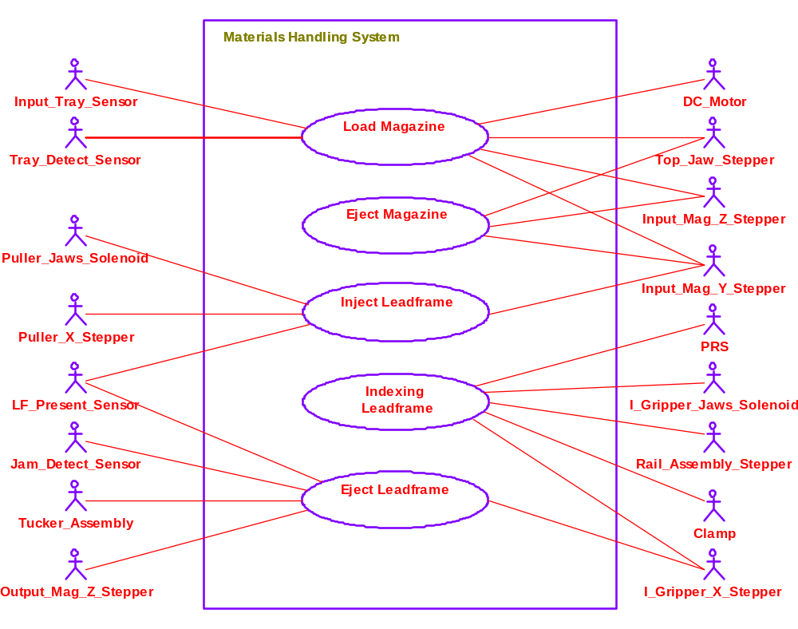
Requirements Capture (Use Case Diagram)
Example: Materials Handling System
Page <number>
H-P Hoffmann, Ph.D. Model-based Systems Engineering

Slide 9
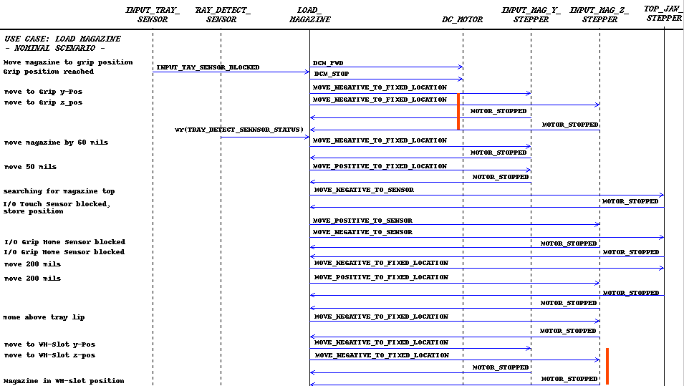
Requirements Capture (Sequence Diagram)
Example: Materials Handling System
Page <number>
H-P Hoffmann, Ph.D. Model-based Systems Engineering

Slide 10
Requirements
Analysis
T
E
S
System
T
Acceptance
    Requirements Analysis
/
P
A
R
A
M
Systems
E
System
Analysis &
T
Integration & Test
Design
E
R
-
D
A
T
HW / SW
A
Design
B
Module
A
Integration & Test
S
E
HW / SW
Implementation
& Unit Test
Requirements captured in use cases and respective scenarios
may be incomplete, ambiguous or even wrong.
Use cases may be translated into executable functional models
(Executable Use Cases) which then are validated through
  Simulation with stimuli derived from respective use case
  scenarios (Sequence Diagrams / Statechart) and
  Formal Verification Analysis
Copyright I-Logix
Page <number>
H-P Hoffmann, Ph.D. Model-based Systems Engineering

Slide 11
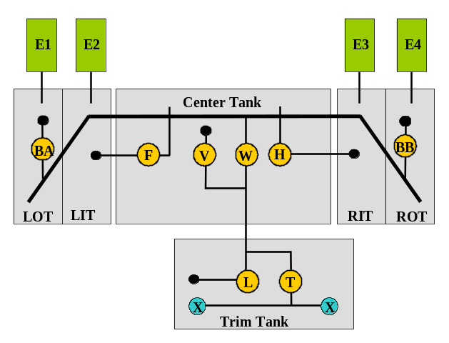
    Requirements Analysis
    Capturing Requirements via Use Cases
    Example: Aircraft Fuel-/Defuel System
Requirements
Analysis
T
E
S
System
T
Acceptance
/
P
A
R
A
M
Systems
E
System
Analysis &
T
Integration & Test
Design
E
R
-
D
A
T
HW / SW
A
Design
B
Module
A
Integration & Test
S
E
HW / SW
Implementation
& Unit Test
Use Case 3:
“Defueling”
Use Case 1:
“Fuel XFR and CG-Control”
Copyright I-Logix
Use Case Scenarios:
Normal Operation:
- Center to Feed Tank Transfer
- Forward Transfers from Trim Tanks
- Aft Transfers to Trim Tank
Operations with Failures:
- Valves failed shut
- Valves failed open
- Pump Failures
Use Case 2:
“Fueling”
Page <number>
H-P Hoffmann, Ph.D. Model-based Systems Engineering

Slide 12
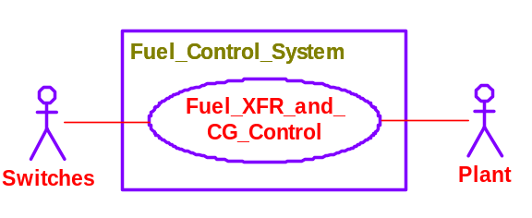
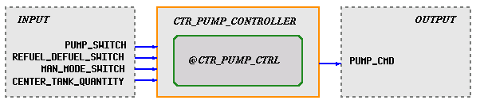
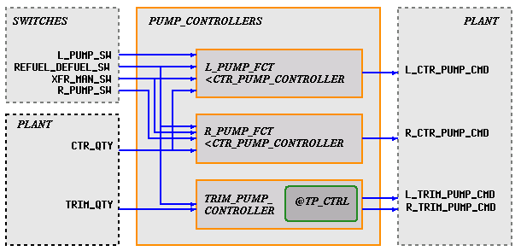
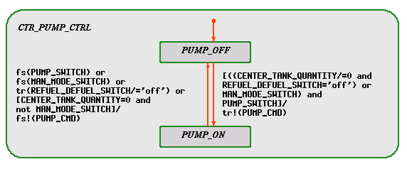
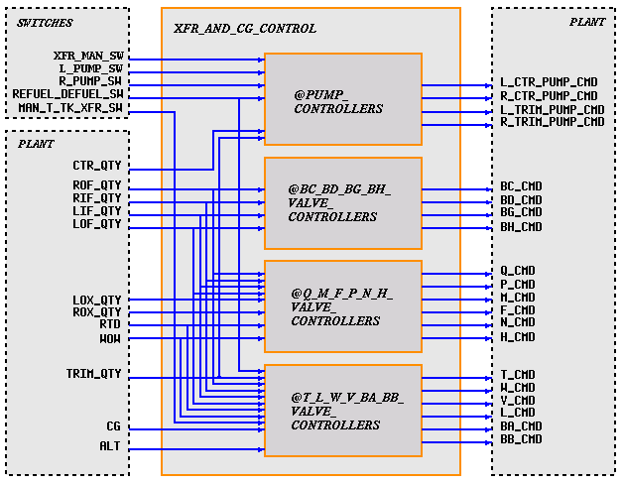
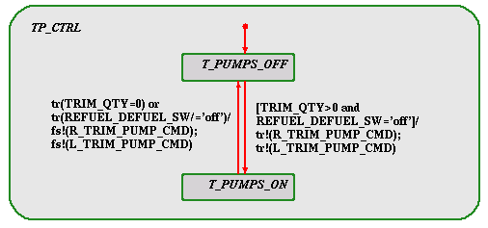
Validation of Requirements through
Executable Use Case Model
USE Case: XFR_AND_CG_CONTROL (Statemate)
Generic Activity
Copyright I-Logix
When the Trim Tank contains fuel and the aircraft is not in refuel or defuel mode then both Trim Tank Transfer Pumps shall be commanded ON otherwise they shall be commanded OFF.
Page <number>
H-P Hoffmann, Ph.D. Model-based Systems Engineering

Slide 13
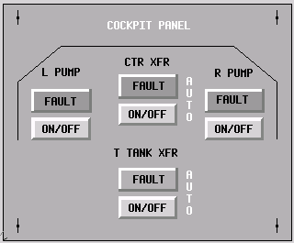
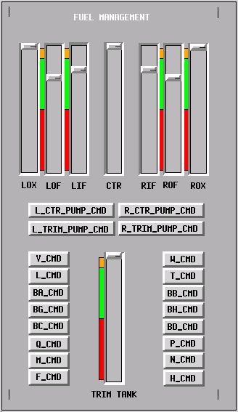
Validation of Requirements through
Executable Use Case Model
USE Case: XFR_AND_CG_CONTROL – Graphical User Interface (Statemate)
Page <number>
H-P Hoffmann, Ph.D. Model-based Systems Engineering

Slide 14
    Benefits from Requirements Modeling
Requirements
Analysis
T
E
S
System
T
Acceptance
/
P
A
R
A
M
Systems
E
System
Analysis &
T
Integration & Test
Design
E
R
-
D
A
T
HW / SW
A
Design
B
Module
A
Integration & Test
S
E
HW / SW
Implementation
& Unit Test
Manage complexity by focusing on specific intended operations
Understand requirements relationship
Generate “Derived Requirements”
Perform preliminary validation of requirements, e.g.
Eliminate ambiguities through model execution
Copyright I-Logix
Page <number>
H-P Hoffmann, Ph.D. Model-based Systems Engineering

Slide 15
Model/Scenario-based System Development
From Requirements Analysis to Systems Analysis & Design
System Modification
Use Case Models
Requirements
Analysis
Test Scenarios
Test Scenarios
System
Acceptance
Copyright I-Logix
Validated
Requirements
incl. executable
Use Case Prototypes
System- /
Performance- Model
Systems
Analysis & Design
Knowledge Base
System
Integration & Test
Implementation Model
HW / SW
Design
Module
Integration & Test
HW / SW
Implementation
& Unit Test
Page <number>
H-P Hoffmann, Ph.D. Model-based Systems Engineering

Slide 16
The Top-Down System Design Process
in Aerospace/Defense
Requirements
V&V Cycle
Requirements
Analysis
Use Case Scenarios
Requirements Capture and
V&V through executable
Use Case Models
Links providing
Traceability of Specs
to original Requirements
V&V Cycle
Test Scenarios /
Test Vectors
if System Architecture tbd
System
Functional
Design
“Conceptual Model”:
Functional Decomposition
down to the Hierarchy Level
where related System States
are captured ( Level ≤ 3)
System Requirements
Document
Copyright I-Logix
V&V Cycle
System
Design *
Grouping of Functionality
System-Level COTS Analysis
Partitioning into Subsystems
V&V Cycle
Subsystem
Functional
Design *
Use Cases Assignment to
Subsystems
Subsystem Requirements
Document
V&V Cycle incl.
RAPID PROTOTYPING
HW/SW Partitioning
Subsystem Analysis of
HW/SW Collaboration
Definition of Subsystem
Interfaces
Subsystem Design *
HW/SW Requirements
Specification
Document
* Concurrent Engineering Task
HW Design & Build
SW Design & Implementation
Page <number>
H-P Hoffmann, Ph.D. Model-based Systems Engineering

Slide 17
Functional Decomposition
The „Top-Down“ Approach
External
Data Sink
External
Data Source
Hierarchy Level 0
(“ Context-Diagram“ )
Copyright I-Logix
Hierarchy Level 1
Top-Down
Hierarchy Level 2
Page <number>
H-P Hoffmann, Ph.D. Model-based Systems Engineering

Slide 18
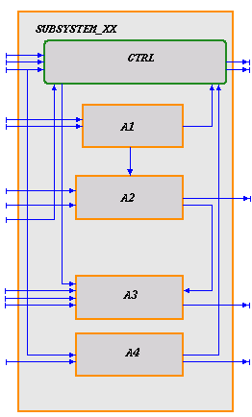
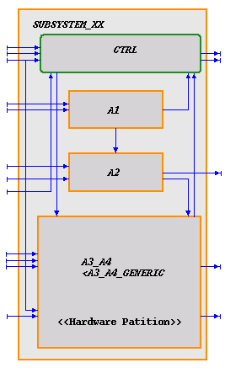
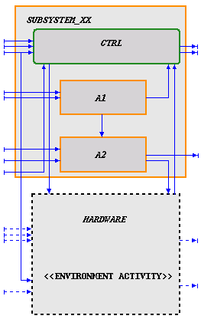
V&V Cycle
The Subsystem Design Process
HW/SW Partitioning (Statemate)
Subsystem
Functional
Design
V&V Cycle incl.
Rapid Prototyping
Subsystem
Design
Subsystem Functional Design
Subsystem Design:
HW/SW Partitioning
Subsystem Design:
Definition of Subsystem Interfaces
Copyright I-Logix
*
*
Analysis of HW/SW Collaboration
Interface to other Subsystems
* may have to be partitioned
Page <number>
H-P Hoffmann, Ph.D. Model-based Systems Engineering

Slide 19

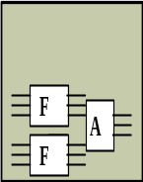





“Feature-based” System Design Approach (Automotive)
Capturing Vehicle-specific Features in a Conceptual System Model
Functional Requirements
Platform independent Feature Library
Copyright I-Logix
Feature
Models
Feature
Models
Feature
Models
Feature
Interaction
Models
Feature
Models
Feature
Models
Power Mirror
Power Window
Seat Heating
Memory Store/Recall
. . . . . . . . . .
Feature
Models
Feature
Models
Exterior Light ( Front, Back, Fog, Wiper/Washer )
Seat Control ( Positioning, Heating, Venting )
. . . . . . . . . . . . . . . . . . . . .
F
F
F
F
F
F
Vehicle System
B
K
X
L
. . .
Test Scenarios
derived from
Requirements
Recorded System Behavior
Process Buffer
S
H
M
P
. . .
Page <number>
H-P Hoffmann, Ph.D. Model-based Systems Engineering

Slide 20
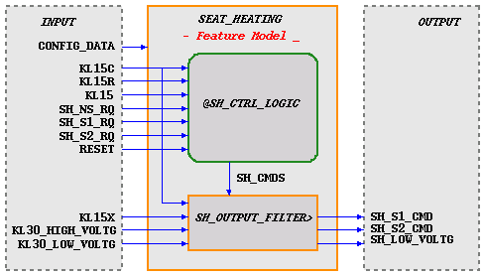
Copyright I-Logix
Feature Model (Statemate):
Seat Heating
started/
SH_S1_CMD:=SH_LVL1_CMD;
SH_S2_CMD:=SH_LVL2_CMD;
SH_LOW_VOLTG:=KL30_LOW_VOLTG;;
--
ch(SH_LVL1_CMD) or ch(SH_LVL2_CMD) or
fs(KL15C or KL15X or
KL30_HIGH_VOLTG or KL30_LOW_VOLTG)/
if not KL15C and not KL15X and
not KL30_HIGH_VOLTG and
not KL30_LOW_VOLTG then
SH_S1_CMD:=SH_LVL1_CMD;
SH_S2_CMD:=SH_LVL2_CMD;
SH_LOW_VOLTG:=KL30_LOW_VOLTG
end if;;
--
tr(KL15C or KL15X or
KL30_HIGH_VOLTG or KL30_LOW_VOLTG)/
fs!(SH_S1_CMD);
fs!(SH_S2_CMD);
SH_LOW_VOLTG:=KL30_LOW_VOLTG;;
Page <number>
H-P Hoffmann, Ph.D. Model-based Systems Engineering

Slide 21
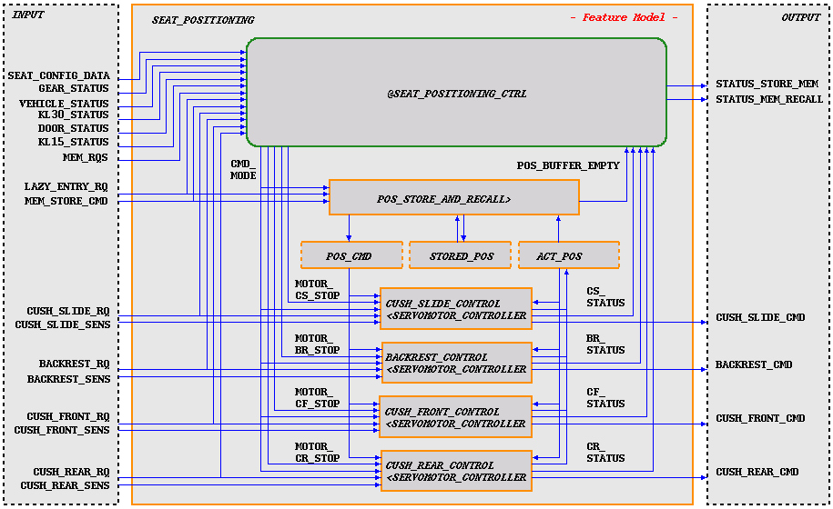
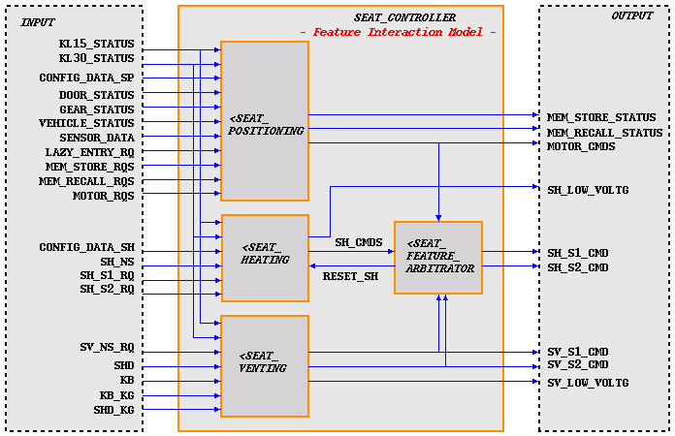
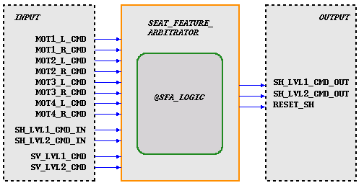
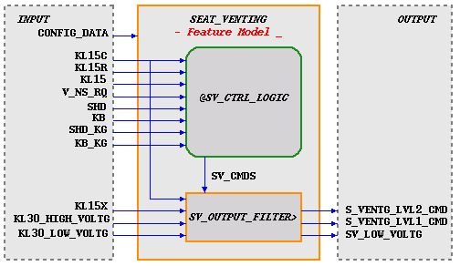
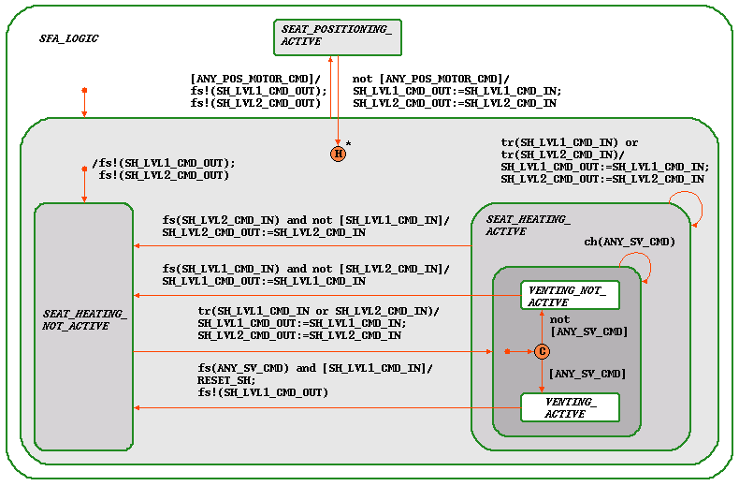
Copyright I-Logix
Feature Interaction Model (Statemate):
Seat Controller
Page <number>
H-P Hoffmann, Ph.D. Model-based Systems Engineering

Slide 22


“Feature-based” System Design Approach
System Partitioning, Parsing of Features/Feature Sub-Functions, and Validation of logical Interfaces
Vehicle System
B
K
X
L
. . .
Test Scenarios
derived from
Requirements
Process Buffer
Copyright I-Logix
S
H
M
P
. . .
Vehicle System
ECU_1 Functions
ECU_N Functions
K
B
. . .
H
X
H
M
Process
Buffer
ECU Test Vector Recording
Page <number>
H-P Hoffmann, Ph.D. Model-based Systems Engineering

Slide 23
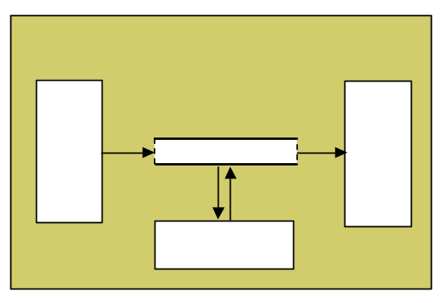
Definition of HW Interfaces and Validation
through Rapid Prototyping
Vehicle System
ECU_1 Functions
ECU_N Functions
Test Scenarios
derived from
Requirements
K
B
. . .
H
X
H
M
Copyright I-Logix
Process
Buffer
ECU_N Functions
H
X
M
ECU_N
H/W Test Vectors
derived from recorded
logical ECU Test Vectors
Input
Filter
Process Buffer
Output
Filter
Bus Interface
Page <number>
H-P Hoffmann, Ph.D. Model-based Systems Engineering

Slide 24


From Function/Data-oriented Systems Engineering
to Object-oriented SW Design
A-D-I-T : Analysis-Design-Implementation-Testing
System Modification
A-D-I-T Cycles
Requirements
Analysis
Test Scenarios
Test Scenarios
System
Acceptance
T
E
S
T
D
B
Requirements
Specification
A-D-I-T Cycles
function/data-oriented
Systems Engineering
Systems
Analysis & Design
System
Integration & Test
HW/SW Requirements
Specification
Implementation
Unit
Testing
Integration
Testing
Testing
object-oriented
SW Design
Coding
Design
Detailed
Design
Validation
Testing
Mechanistic
Design
Iterative
Prototypes
Page <number>
H-P Hoffmann, Ph.D. Model-based Systems Engineering

Slide 25
Model-based Systems Engineering
    1. Process Overview:
    Model-based System Development
        The “V” Development Process
        Requirements Capture (“Use Cases”)
        Systems Analysis and Architectural Design
        Transition to SW Design
    2. Modeling Languages
    3. Model-based Verification/Validation
    4. Documentation in a Model-based Development
Page <number>
H-P Hoffmann, Ph.D. Model-based Systems Engineering

Slide 26
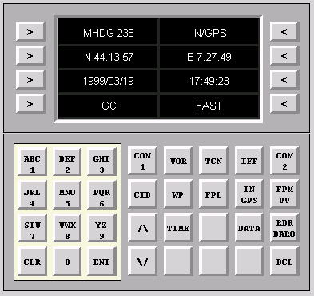
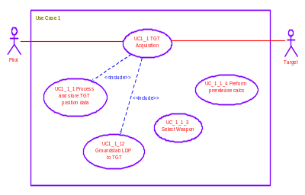
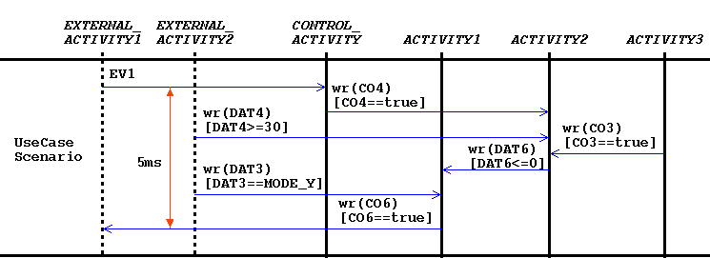
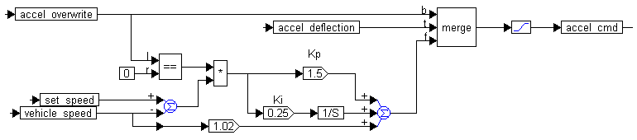
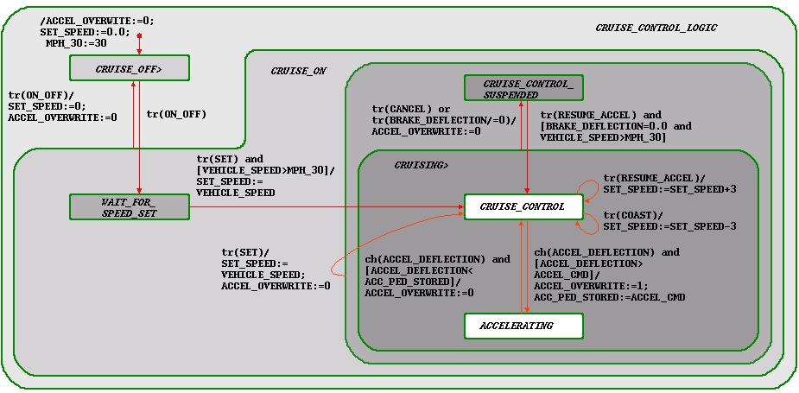
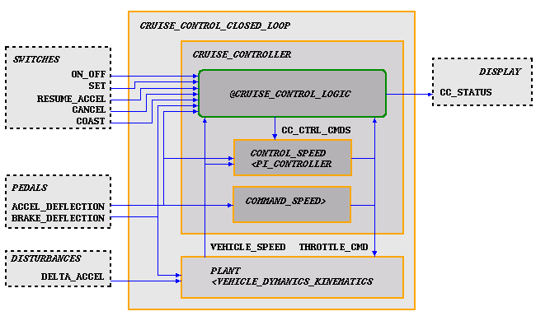
Modeling Languages (Statemate)
The different “Views” to a System
User Interface View
Use Case View
Use Case Scenario View
Time-continuous Behavioral View
Copyright I-Logix
State-based Behavioral View
Panel
Use Case Diagram
Sequence Diagram
Functional / Architectural View
SYSTEM
Time-continuous Diagram
Statechart
Statemate
Activity Chart
Page <number>
H-P Hoffmann, Ph.D. Model-based Systems Engineering

Slide 27

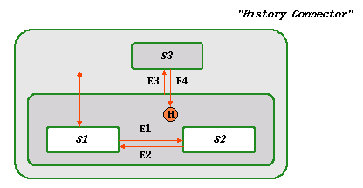
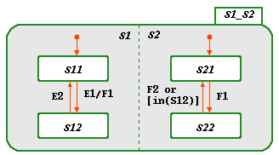
Modeling Languages
Definition of Statecharts
Finite State Machine (FSM):
A virtual machine that can be in any one of a set of finite states and whose next states and outputs are functions of input and current states.
Copyright I-Logix
+ Hierarchy:
Structure:
A state may consist of states which consist of states …
Priority rule for transitions:
Priority is given to the transition whose source and target states have a higher common ancestor state.
+ Concurrency:
Description of independent - or almost independent – parts of system behavior (e.g. subsystems) in a single Statechart.
Synchronization through Broadcasting.
Page <number>
H-P Hoffmann, Ph.D. Model-based Systems Engineering

Slide 28
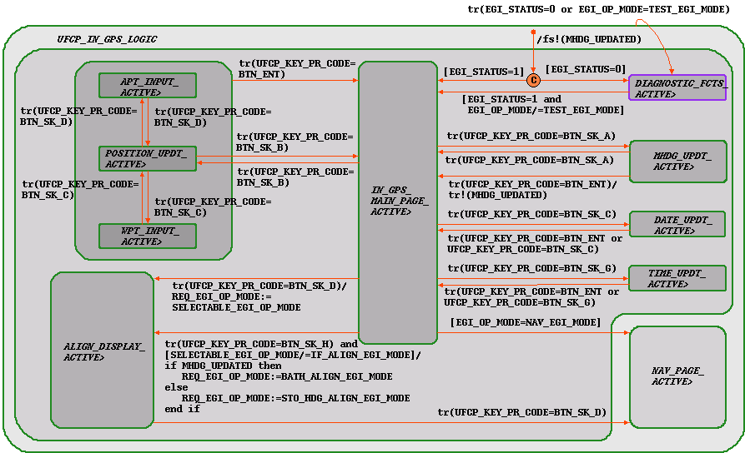
The Statechart Language
Describing Interrupt Priorities through Hierarchies
Page <number>
H-P Hoffmann, Ph.D. Model-based Systems Engineering

Slide 29
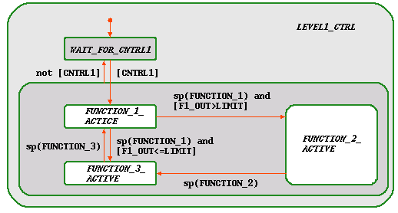
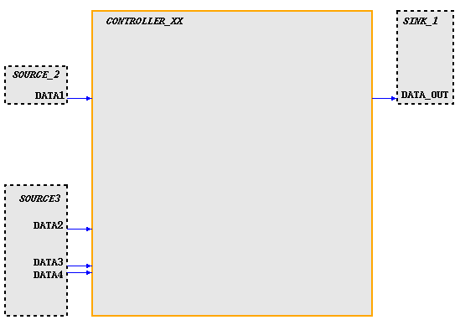
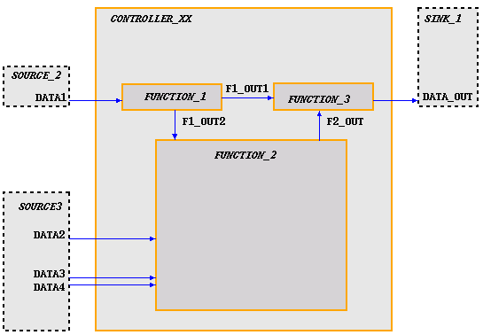
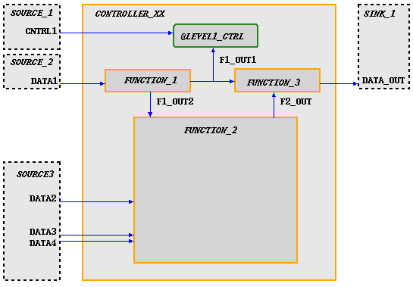
Modeling Languages
Functional Description through Activity Charts
Copyright I-Logix
Statechart
Activity Chart
Page <number>
H-P Hoffmann, Ph.D. Model-based Systems Engineering

Slide 30
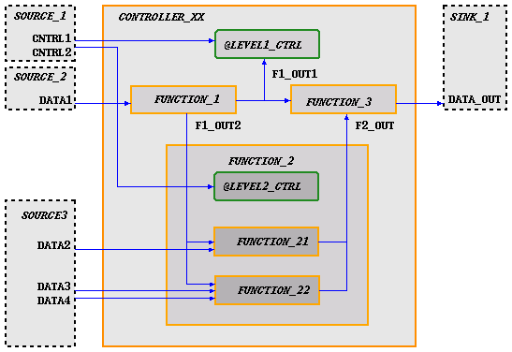
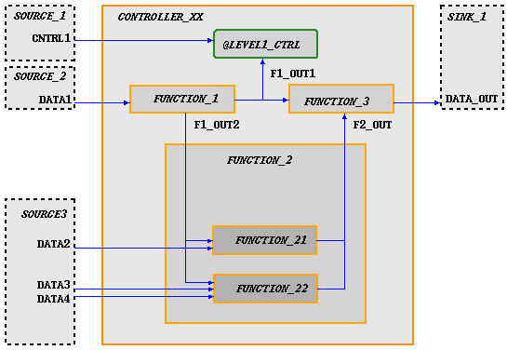
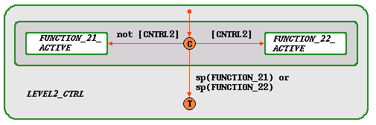
Activity Charts
Encapsulation of Activities
Copyright I-Logix
Statechart
Activity Chart
Page <number>
H-P Hoffmann, Ph.D. Model-based Systems Engineering

Slide 31
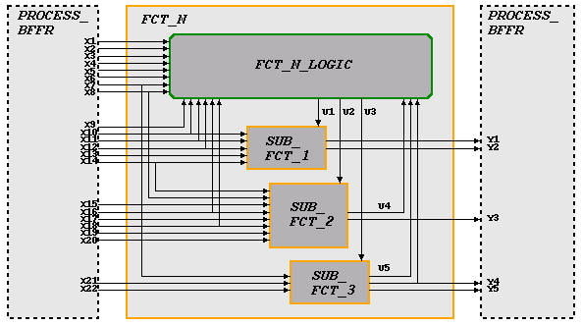

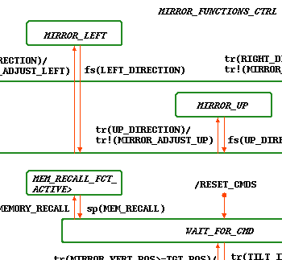
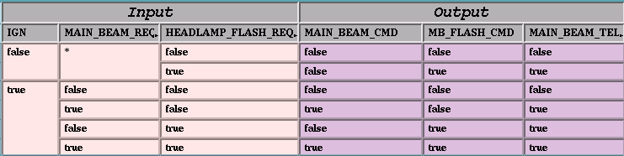
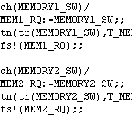
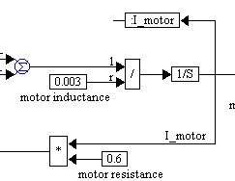
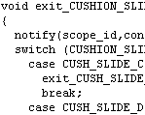
Activity Charts
Describing Basic Function-Blocks (“Basic Activities”)
Copyright I-Logix
Statemachines
(Statechart)
Truthtables
Mini-Spec
Continuous Diagrams
(Legacy) C-Code
Page <number>
H-P Hoffmann, Ph.D. Model-based Systems Engineering

Slide 32
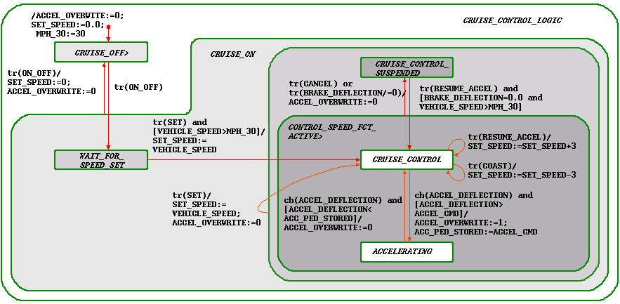
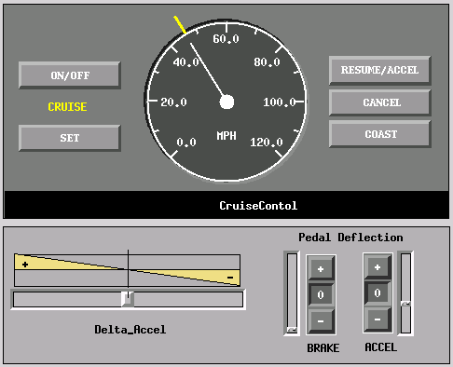
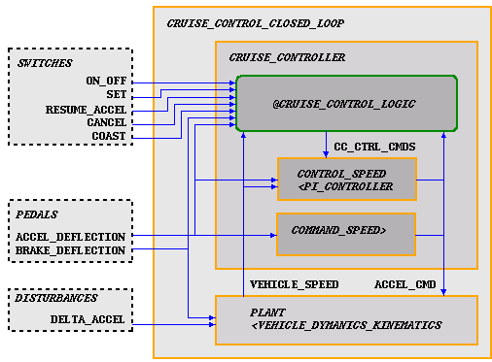


Modeling Languages (Statemate)
“Hybrid” ( = state-based & time-continuous/time-discrete) Modeling
(Example: Simplified Model of a Cruise Control )
Copyright I-Logix
PI_Controller
Vehicle_Dynamics_Kinematics
started/
ACCEL_CMD:=GAIN_ACC*ACCEL_DEFLECTION;;
tm(wr(ACCEL_CMD),0.1)/
ACCEL_CMD:=GAIN_ACC*ACCEL_DEFLECTION;;
Page <number>
H-P Hoffmann, Ph.D. Model-based Systems Engineering

Slide 33
Model-based Systems Engineering
    1. Process Overview:
    Model-based System Development
        The “V” Development Process
        Requirements Capture (“Use Cases”)
        Systems Analysis and Architectural Design
        Transition to SW Design
    2. Modeling Languages
    3. Model-based Verification/Validation
    4. Documentation in a Model-based Development
Page <number>
H-P Hoffmann, Ph.D. Model-based Systems Engineering

Slide 34

Executable Specification (Statemate)
Example: Mission Computer Symbol Generator (UFCP)
Copyright I-Logix
Page <number>
H-P Hoffmann, Ph.D. Model-based Systems Engineering

Slide 35




Model Verification / Validation through Simulation (Statemate)
Test-Data
Generation
via GUI
Seat-Heating Module
(Functional Model)
Simulation Output: Waveform Diagram
Copyright I-Logix
Requirements Scenario SH-005
Page <number>
H-P Hoffmann, Ph.D. Model-based Systems Engineering

Slide 36


Model Verification / Validation
Test-Script Generation and Re-Use of Tests
Requirements related Test-Vectors ( Playback File)
Copyright I-Logix
2. BEHAVIORAL DESCRIPTION
1. FUNCTIONAL DESCRIPTION
Testbench for Unit-Test
i.e. HP ECUTEST
Test
Patterns
S/W Requirements
Specification
Test
Input
ECU
Actual
Output
RQ
Output
Output
Analysis
Page <number>
H-P Hoffmann, Ph.D. Model-based Systems Engineering

Slide 37
Model Verification / Validation
Extended System Analysis
A system specified by means of a Formal Specification Language,
may be amenable to Formal Verification.
Formal Verification increases the safety of a design by mathematically
  Proving that disastrous situations never happen
  Based on the description of an unwanted situation the
  algorithm will check for the respective safety bug
  Ensuring expected situations are reachable
  “Drive to State / Drive to Configuration”
Formal Verification may also be used to automatically generate
test cases for unit, module, and integration testing
Page <number>
H-P Hoffmann, Ph.D. Model-based Systems Engineering

Slide 38
Model Verification / Validation
Code Generation
A system specified by means of a Formal Specification Language
may be amenable to Code Synthesis , e.g. C-Code or VHDL-Code
During the Requirements Analysis Phase a “Soft Prototype”
together with a graphical User Interface may be used as a first
“Proof of Concept” or for marketing purposes
During the System Design Phase, code generation may help to
  Validate Hardware/Software partitioning
  (“Hardware/Software Co-Design”)
  Validate the design in its real environment
  by porting it to some prototyping hardware
  (“Rapid Prototyping”)
Copyright I-Logix
Page <number>
H-P Hoffmann, Ph.D. Model-based Systems Engineering

Slide 39




Functional Model Verification / Validation
Rapid Prototyping
Model (Back-) Animation
Copyright I-Logix
parallel/ serial
MIL 1553B
Prototype Target Unit
UNIX / NT
TCP/IP
Statemate MAGNUM generated
code running on RTOS (e.g. VxWorks)
Page <number>
H-P Hoffmann, Ph.D. Model-based Systems Engineering

Slide 40
Model-based Systems Engineering
    1. Process Overview:
    Model-based System Development
        The “V” Development Process
        Requirements Capture (“Use Cases”)
        Systems Analysis and Architectural Design
        Transition to SW Design
    2. Modeling Languages
    3. Model-based Verification/Validation
    4. Documentation in a Model-based Development
Page <number>
H-P Hoffmann, Ph.D. Model-based Systems Engineering

Slide 41
Documentation in a Model-based Development
A system specified by means of a Formal Specification Language
implies a paradigm shift in documentation.
Since by definition the system under design is described
unambiguously, no additional “descriptive” text is needed.
The additional information should be restricted to remarks like
  Quality of Service Requirements or
  Requirements Traceability information.
Page <number>
H-P Hoffmann, Ph.D. Model-based Systems Engineering

Slide 42


Model Documentation (Statemate)
Example: STORES MANAGEMENT SYSTEM
hierarchical order
of Activity Charts ➔
Copyright I-Logix
Page <number>
H-P Hoffmann, Ph.D. Model-based Systems Engineering

Slide 43

Model Documentation (Statemate)
Example: STORES MANAGEMENT SYSTEM
Copyright I-Logix
alphabetical order
of Statecharts ➔
Page <number>
H-P Hoffmann, Ph.D. Model-based Systems Engineering

Slide 44

Model Documentation (Statemate)
Example: STORES MANAGEMENT SYSTEM
Copyright I-Logix
Optional:
alphabetical order ➔
Page <number>
H-P Hoffmann, Ph.D. Model-based Systems Engineering

